Slide 1
Lounge against the machine
Presentation for the Butterfield Cup – Part One

Slide 2
Who are we?
Joe Manke – Product Owner
Adam Meaney – Scrum Master
Known each other for 7 years
Working together for 3 years

Slide 3
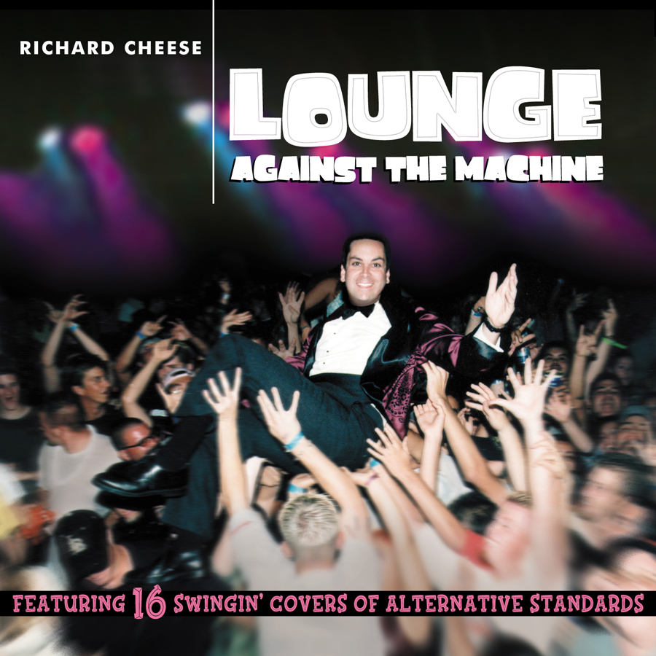
The “lounge” brand
Our mission: to lounge as much as possible while delivering quality software
Relaxed approach to development
Name inspired by the Richard Cheese album

Slide 4
The product
Automatic Program Tester
The need: ease of program grading for computer science professors
No longer need to write test cases by hand
Can run all test cases against all students automatically

Slide 5
Marketing/distribution
Market to universities
Download source code, makefile, documentation online
License product to university

Slide 6
support
Licensed with GNU General Public License
Allow customers to modify code
Documentation provided
Release updates online with notification
Support email account

